Slide 3
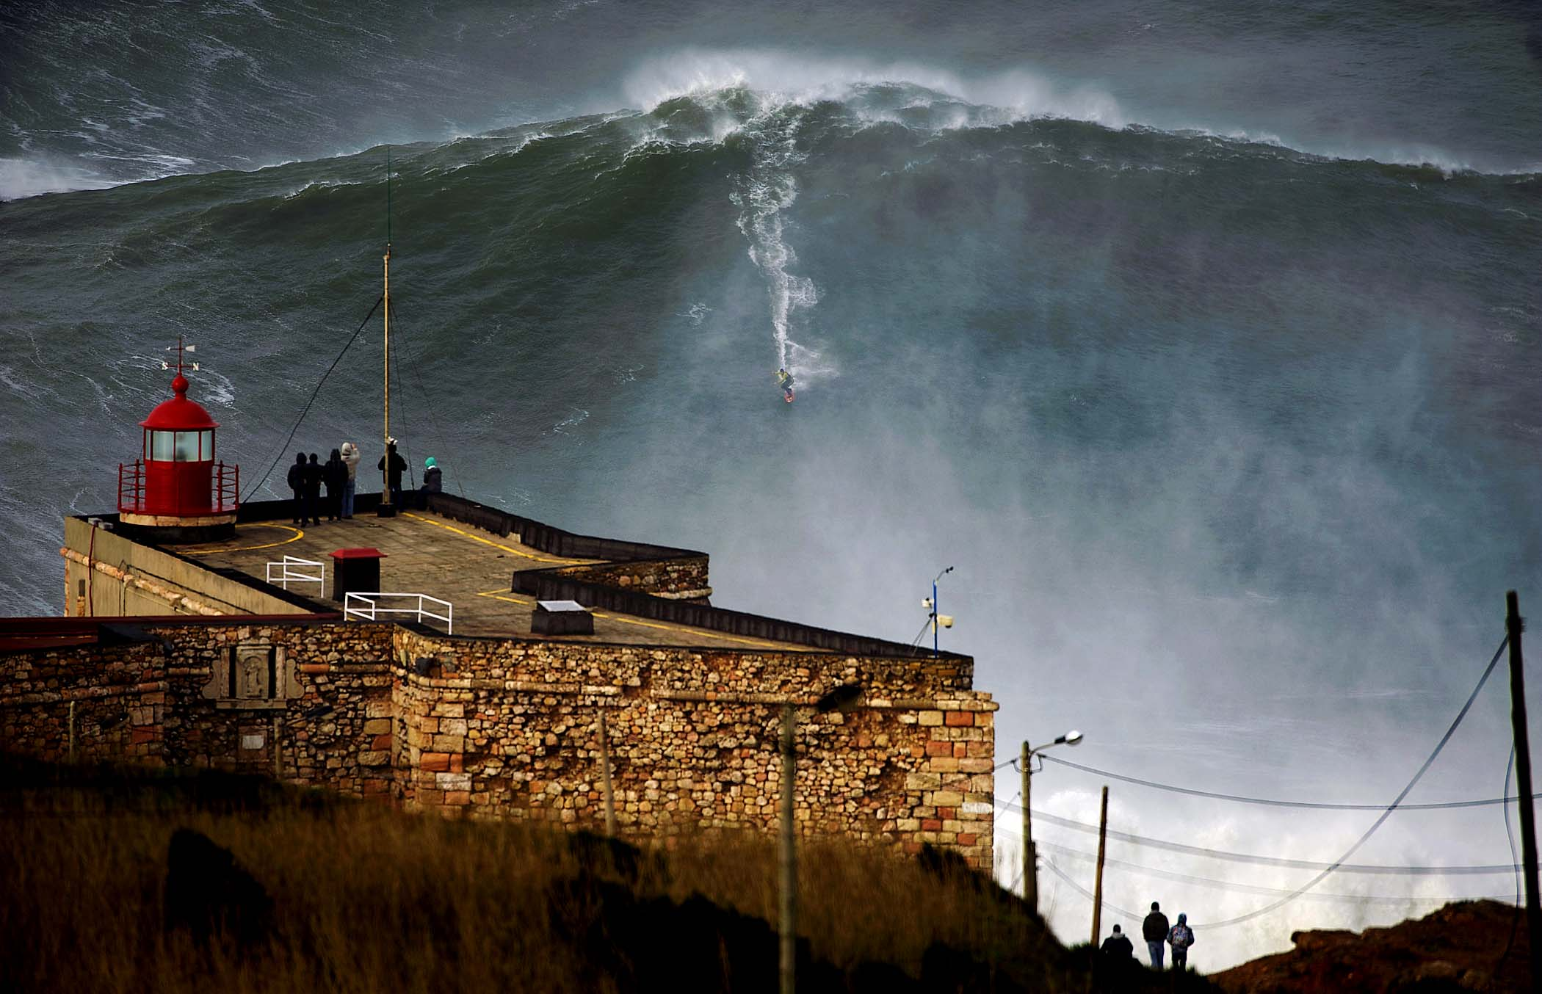

Slide 4
Disciple Makers Pray Abundantly

Slide 5
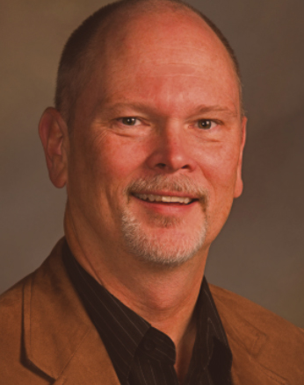

Slide 6
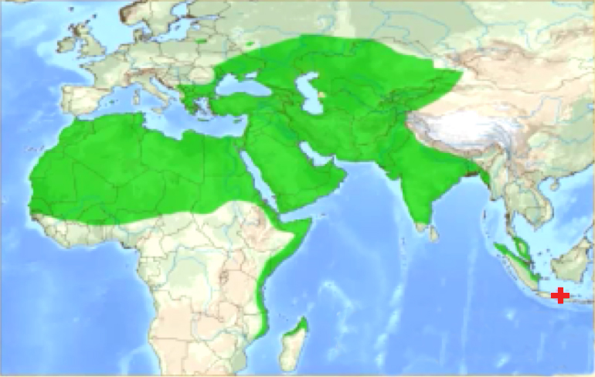
MUSLIM MOVEMENTS TO CHRIST - 19th CENTURY

Slide 7
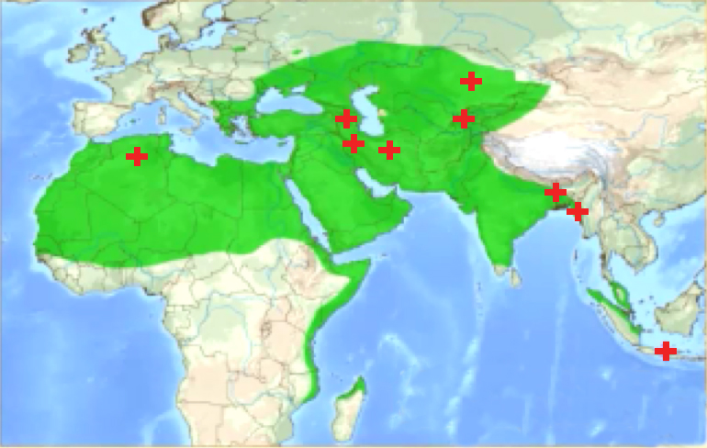
MUSLIM MOVEMENTS TO CHRIST - 20th CENTURY

Slide 8
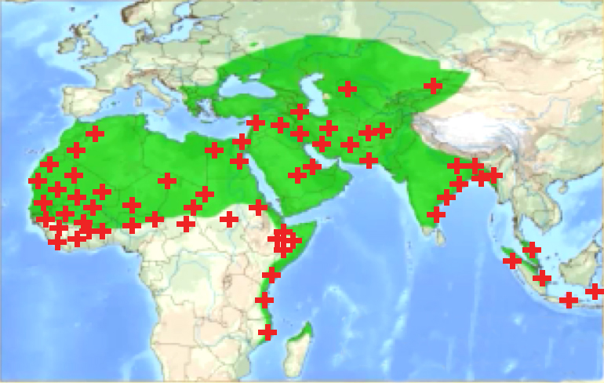
MUSLIM MOVEMENTS TO CHRIST - 21st CENTURY

Slide 10
Disciple Makers Pray Abundantly

Slide 11
Disciple Makers Look for People of Peace

Slide 12
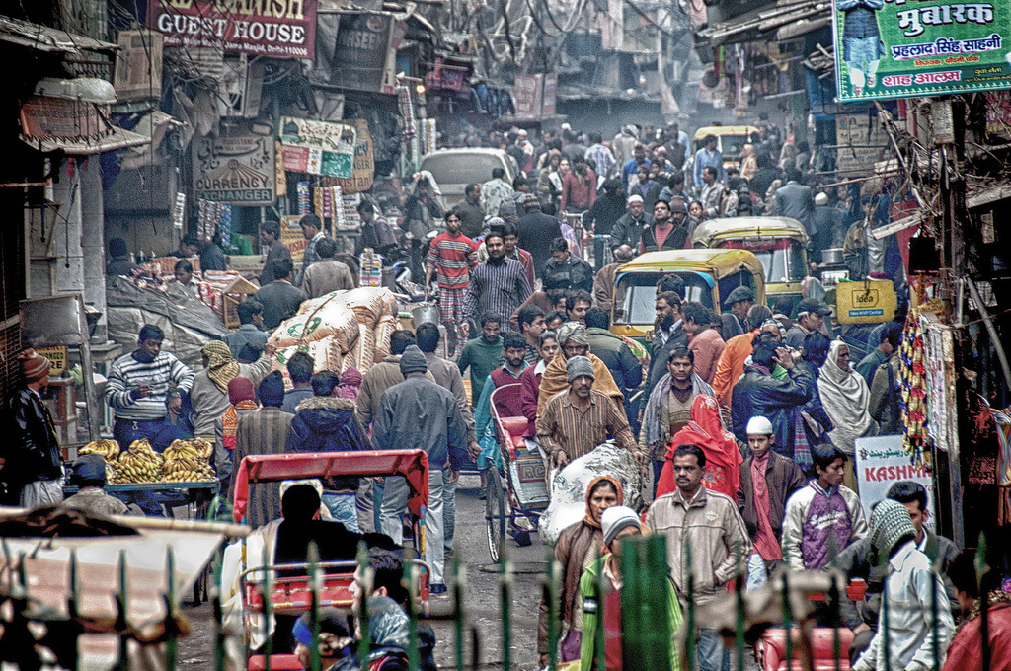

Slide 13
Disciple Makers Look for People of Peace

Slide 14
Disciple Makers Share Christ in both Word and Deed

Slide 15
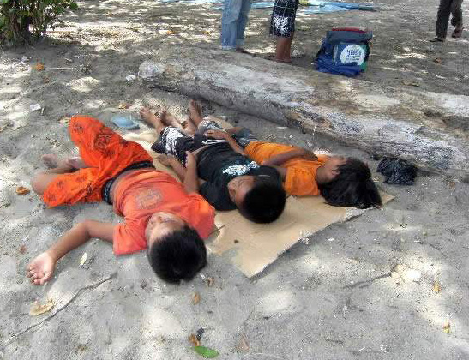

Slide 16
Disciple Makers Share Christ in both Word and Deed

